Slide 1
Hack the Future:
A Gen AI Sprint
Powered by Data

Slide 2





Hack the Future:
A Gen AI Sprint
Powered by Data
Data and AI Week
Team details
TEAM NAME:
B VENEETH
M SRIKANTH
Photo

Slide 3
Entry Submission Summary
Idea Title (Provide a concise and impactful title for your idea.) | "Enhancing Customer Support Efficiency with Multi-Agent AI Automation"
Team Name | VS_Team
Problem Statement | Current customer support bots, largely driven by static rule sets, often fail to handle complex or context-specific issues, resulting in unresolved queries and user dissatisfaction. This limitation became evident during my own experience with a secure online examination platform, where a support bot's inability to address a technical issue led to a missed exam opportunity. To overcome such challenges, we developed a Multi-Agent AI-Driven Customer Support System that leverages intelligent agents to collaboratively analyze conversations, extract actionable insights, suggest resolutions, and route tickets efficiently. By learning from past interactions and maintaining structured issue logs, the system delivers accurate, context-aware support, significantly improving response times and user satisfaction.
Proposed Solution | To address the inefficiencies in traditional customer support systems, we developed a Multi-Agent AI-Driven Support System using LLM-powered agents orchestrated via AutoGen. Each agent performs a specialized task—such as summarizing conversations, extracting actions, routing tickets, recommending resolutions, and estimating resolution time—working collaboratively through structured communication. The system utilizes Chromadb for contextual memory management and long-term knowledge retrieval. It is deployed through an intuitive Streamlit interface, enabling real-time interaction and end-to-end automation. This modular, scalable design ensures faster response times, improved accuracy, and enhanced customer satisfaction while significantly reducing manual workload.

Slide 4
Problem statement you are trying to address
In the current technological landscape, most online services rely on customer support bots to handle user queries. However, these bots are often based on predefined rule sets and limited conversational capabilities, which restrict their ability to understand complex or context-specific problems. As a result, users frequently encounter unresolved issues, leading to frustration and missed opportunities.
I personally experienced such a situation during an online examination conducted through a secure exam browser. When I encountered a technical issue, I reached out to the platform's customer support bot. Unfortunately, the bot failed to understand and resolve my problem, which ultimately caused me to miss the examination opportunity. This incident highlighted a significant gap in the effectiveness of current automated support systems.
To address this challenge, we developed a Multi-Agent AI-Driven Customer Support System designed to provide accurate, context-aware, and efficient issue resolution. Unlike traditional bots, our system employs multiple intelligent agents that collaboratively analyze the conversation, extract actions, suggest resolutions, and route tickets to the appropriate department. Additionally, the system automatically generates support tickets and logs resolved issues in a structured database, allowing it to learn from past cases and improve future responses.
This approach not only enhances the quality of customer support but also significantly reduces response times and increases user satisfaction by providing tailored and intelligent assistance.

Slide 5
Proposed Solution Overview
We propose a Multi-Agent AI-Driven Customer Support System that automates and optimizes end-to-end support workflows using specialized AI agents orchestrated via Microsoft AutoGen.
🔹 Core Methodology
The system breaks down the support process into modular agents, each handling a specific task:
Conversation Summarizer Agent: Extracts key insights from chat history.
Action Extractor Agent: Identifies customer intents and required actions.
Resolution RecommenderAgent: Suggests solutions using semantic search over a knowledge base.
Task Router Agent: Classifies and assigns queries to appropriate departments.
Resolution Estimator Agent: Predicts resolution time based on ticket complexity.
Agents communicate through shared memory (SQLite) and utilize a vector store (ChromaDB) for contextual retrieval. LLMs (OpenAI/Ollama) are integrated via few-shot prompts tailored to each agent's role.
🔹 Architecture Highlights
Built using AutoGen for multi-agent coordination.
Modular design enables easy agent extension and scalability.
Deployed the bot on streamline

Slide 6
Technologies Used
1. AI Integration Using Gemini 2.0 Flash via Generative API
Models Used: gemini-2.0-flash
Description: Integrated gemini-2.0-flash through the generative-api to power AI agents capable of tasks like conversation summarization, action extraction, and resolution recommendation.
This setup ensures high performance with seamless access to state-of- the-art language capabilities via API
2. AutoGen – Multi-Agent Framework
Enables coordination among specialized agents, each handling a distinct support function like summarization, extraction, and resolution generation.
3. ChromaDB – Vector Database
Stores and retrieves semantic embeddings of past tickets to provide context-aware responses and improve resolution accuracy.
4. SQLite – Structured Memory Storage
Used to persist support ticket data, agent outputs, and resolved cases for future reference and learning.
5. Streamlit – User Interface & Deployment
Hosts the system via an interactive web interface, enabling real-time user-agent interaction and seamless deployment.

Slide 7
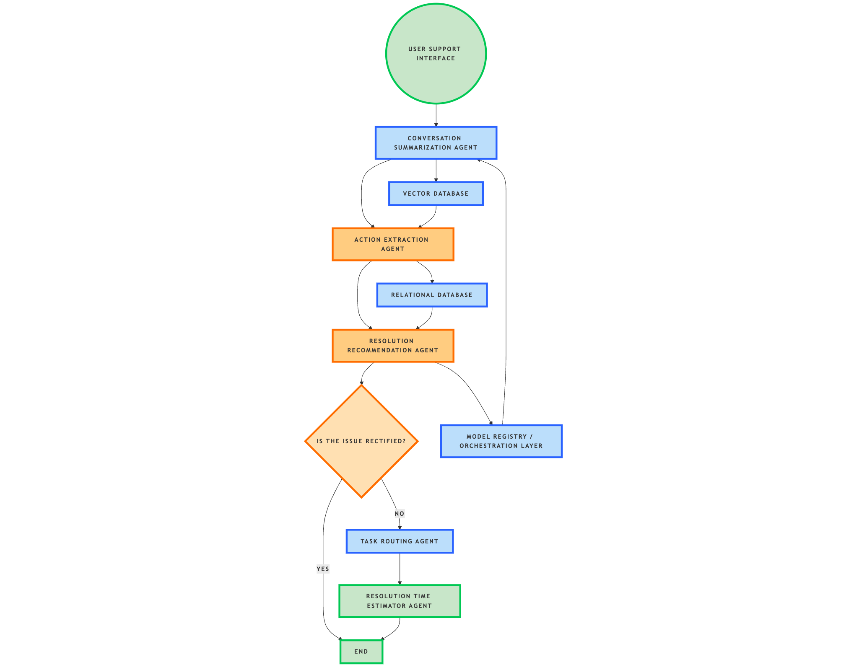

Agents' interaction design
Conversation Summarization Agent
Action Extraction Agent
Resolution Recommendation Agent
Task Routing Agent
Time Estimation Agent

Slide 8
Code structure
————Customer Support Multi-agent System
  agents
    ————summarization_agent.py - Summarizes the conversation
    ————action_extarction_agent.py. - Extracts the action items from conversation summary
    ————resolution_recommndetion_agent.py. - Recommend resolution based on action items
    ————task_routing_agent.py. - Assign the issues to relevant department (team)
    ————vector_db.py - embed and store the ticket_data to the chromadb
    ------------gen_model.py
  chroma_db
    ————chroma.sqlite3 - Chroma Database
  data
    ————Historical_ticket_data.csv
  main_agent2.py
  routed_tickets.xlsx
  gen_model.py

Slide 9
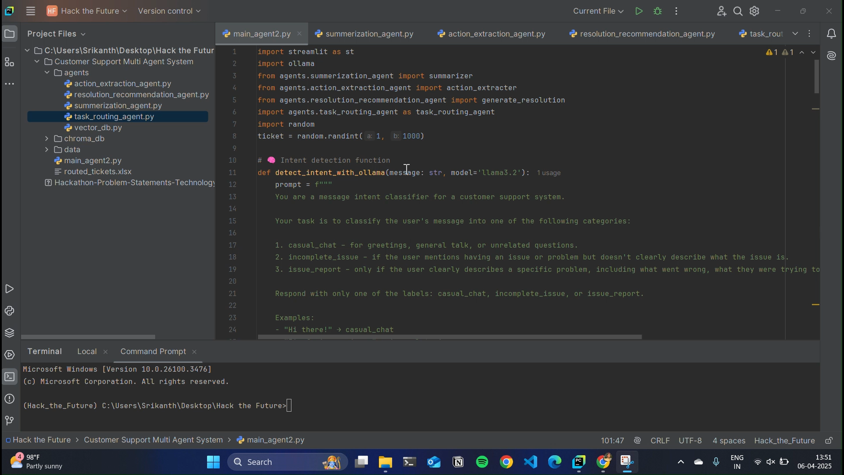
Demo video

Slide 10
Conclusion
The proposed solution effectively addresses the inefficiencies in traditional customer support by introducing intelligent automation through a multi-agent architecture. Each agent independently performs a specialized task—understanding conversations, extracting actions, routing tickets, recommending resolutions, and estimating timelines—leading to a modular, explainable, and scalable system.
🔹 Key Impacts
Reduced Resolution Time: Automated triaging, summarization, and resolution recommendation minimize human intervention and expedite response times.
Improved Accuracy & Consistency: LLM-driven agents ensure standardized interpretation and action planning across varied queries.
Enhanced Customer Experience: Proactive and context-aware responses improve user satisfaction and reduce escalation rates.
Operational Efficiency: Automating repetitive and cognitive tasks allows human agents to focus on complex cases, improving overall workforce productivity.
Scalability & Adaptability: The modular agent-based design allows seamless expansion to new domains, languages, or support categories.
🔁 Reinforcing Problem-Solution Fit
The solution directly tackles the core problem of delayed, inconsistent, and manually intensive customer support workflows by introducing intelligent, autonomous agents that can reason, collaborate, and adapt in real-time. By leveraging large language models, vector-based knowledge retrieval, and structured agent communication, the system transforms support into a fast, context-aware, and self-improving service pipeline.

Slide 11
References/Other details
Blog on multi-agent framework:https://www.superannotate.com/blog/multi-agent-llms
Research Paper:”LLM Multi-Agent Systems: Challenges and Open Problems”:
https://arxiv.org/pdf/2402.03578
Video on Ai agents:https://www.youtube.com/watch?v=F8NKVhkZZWI&pp=ygUSbXVsdGkgYWdlbnQgc3lzdGVt

Slide 12

Thank You

